Slide 1

SAP BTP ABAP on Cloud / RAP Training
DAY-2
Anubhav Oberoy
www.AnubhavTrainings.com
Follow excellence with sheer passion

Slide 2


DISCLAIMER
The training content and delivery of this presentation is confidential, and cannot be recorded, or copied and distributed to any third party, without the written consent of Anubhav Trainings

Slide 3
Agenda
01
CDS entities
02
Types of Entities
03
Hands-on CDS
04
RAP Introduction
www.anubhavtrainings.com

Slide 4

CDS – Core Data & Services
CDS is the new approach of building semantically rich data models. It is an extension of SQL in ABAP world.
What has been extended?
DDL – Data definition language – design new data models – new tables, structures
DQL – Data Query Language (CDS Views and CDS Entities) – new views to extract data (agg., join, load, calculate,formulas)
DEL – Data Expression language (expressions like path expression, case expressions)
DCL – Data Control Language (security)
Since in ABAP on Cloud Environment we do not have GUI access (no access to SE11) – we will use CDS
Naming convention – is a best practice to follow in a project. ZCOMPANY_PROJ_OBJTTP_NAME
ZDXC_XX_*
We will use an uploader utility provided by SAP, get this in our ABAP on Cloud System to test it
Install the abap git plugin so we can interact with github from our adt tool - http://eclipse.abapgit.org/updatesite/
Download the code from SAP standard repository - https://github.com/SAP-samples/abap-file-uploader
Register a service
Run the utility
www.anubhavtrainings.com

Slide 5
CDS Views
CDS stands for Core data and services, it is an extension of SQL in ABAP and used effectively on any ABAP on HANA system in order to boost our performance. CDS views are semantically (annotations @) rich data model.
What has been extended? What SQL can do, CDS can also do?
DDL – data Definition language
DQL – Data Query Language → CDS view concept to fetch data from HANA using code-to-data
DCL – Data Control Language
DEL – Data Expression Language
Does CDS only used for building views or are there other use cases?
You can create any DDIC object like structure, table etc. most used concept is views (DQL)
Can I create cds views if my company is not on HANA DB or S/4HANA systems
Yes, starring NW 7.4SP2 onwards. The best performance will come when you are on HANA.
Like AMDP, do I need to also do client handling
No, CDS views are created and managed in ABAP layer so client handling is automatic
If I have been a choice between CDS or AMDP, what should be preferred?
It depends on requirement. First attempt will be with CDS view last choice should AMDP
www.anubhavtrainings.com
7

Slide 6
Continue 1/3
Which tool can I use to create CDS views?
Only and only ADT
Which system does the CDS view gets created and transported?
It’s the ABAP system, there no need to login to HANA DB using studio.
What happens after I activate my CDS view.
I heard that CDS views are deprecated, is it true, if yes, what can I use?
Yes. There is a successor concept called cds entities which is exact same as CDS view but small difference.
What is the difference between CDS views and Calculation views.
The calculation views are created in HANA they are bottom-up approach and transport using Delivery Unit
The CDS views are created in ABAP layer they are top-down approach and transport using ABAP tr.
SE11 – DDIC view
CDS view data definition
HANA View
(runtime object in HANA)
www.anubhavtrainings.com
7

Slide 7
Continue 2/3
Can a non-ABAP developer also learn CDS views?
Yes, anyone can learn cds views w/o any abap knowledge
I tried learning CDS views from google/YouTube but I failed.
Park*
Does SAP deliver standard CDS views for us to use directly in S/4HANA?
Yes, these views become the backbone for S/4HANA. We can see them on a website https://api.sap.com
Can I enhance a standard SAP delivered CDS view
We have a extension concept of cds
What is the best practice/gold standard to create cds views in SAP S/4HANA?
SAP offer something called VDM (Virtual Data Modelling) which is a gold standard to build cds views in SAP S/4HANA.
www.anubhavtrainings.com
7

Slide 8
Continue 3/3
What the difference between HANA CDS and ABAP CDS?
If your company does not have ABAP system, when our company buy only HANA license for database. These cases we have no abaper in team, we use native HANA development, so we create HANA CDS. This course focus on S/4HANA which is a solution based on ABAP system hence we cover only ABAP CDS.
https://youtu.be/rTsAg_OGh-A
There are already DDIC view (SE11), why SAP come up with CDS views?
Park*
Can I integrate SQL Script also with CDS views?
Yes, with SAP NW 750 onwards, we have new concept called CDS table function
Is it possible to also insert data using CDS views?
No, it’s a view. But if you combine another concept with cds like BOPF or RAP framework.
www.anubhavtrainings.com
7

Slide 9
CDS entities
CDS entities are advance version of CDS Views. If you know CDS view, you can implement CDS entities very easily
When we activate CDS view, 2 objects gets created. One will be HANA view, and another will be the DDIC view. This DDIC view is of no use. When we CDS entity, No DDIC view gets created.
It save activation time hence the cds entity activation is faster than the cds view activation.
A view have 3 names – file name, cds name and ddic view name. CDS entity is simplified and just have only one name
SAP also improved the runtime engine for entities to make it work faster
CDS entities are strict in nature.
ABAP on Cloud system
SAP does not allow direct access of some of standard database tables available in AOC environment. These objects are called restricted objects. SAP have built the CDS entities on top of these objects, these entities are marked as Released. Which means we can use them in our code.
www.anubhavtrainings.com

Slide 10




Challenges in ABAP development
UI
Common needs
Create application logic
Insert, update, delete, validate, select data
Perform validations
Check customizing
Handle locks
Create A/c documents
Manage Documents
Application Code
I, U, D, S, V
Search Documents
Validate before save
Alex, ABAP Developer,
SAP FICO
UI
Challenges
Thinks differently
Adapt application code
High maintenance
No standardization
Different coding practices
Lack of standard
Create Sales Orders
Manage Sales Orders
Application Code
I, U, D, S, V
Search/Filter Sales Order
Compute Sales total
Stella, ABAP Developer,
SAP SD
www.anubhavtrainings.com

Slide 11
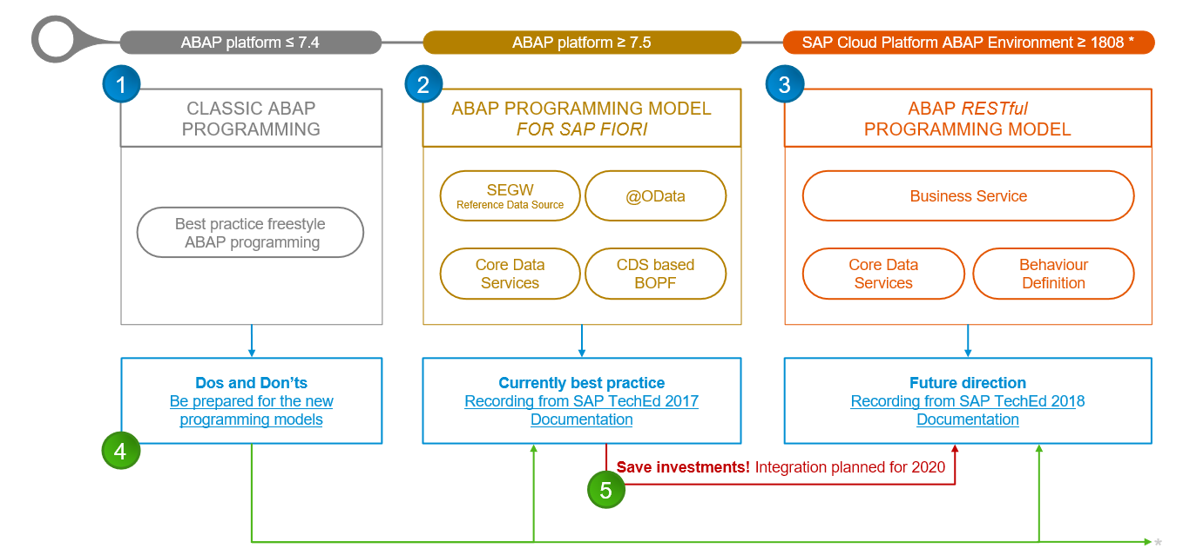
Evolution of ABAP Programming Model
www.anubhavtrainings.com

Slide 12
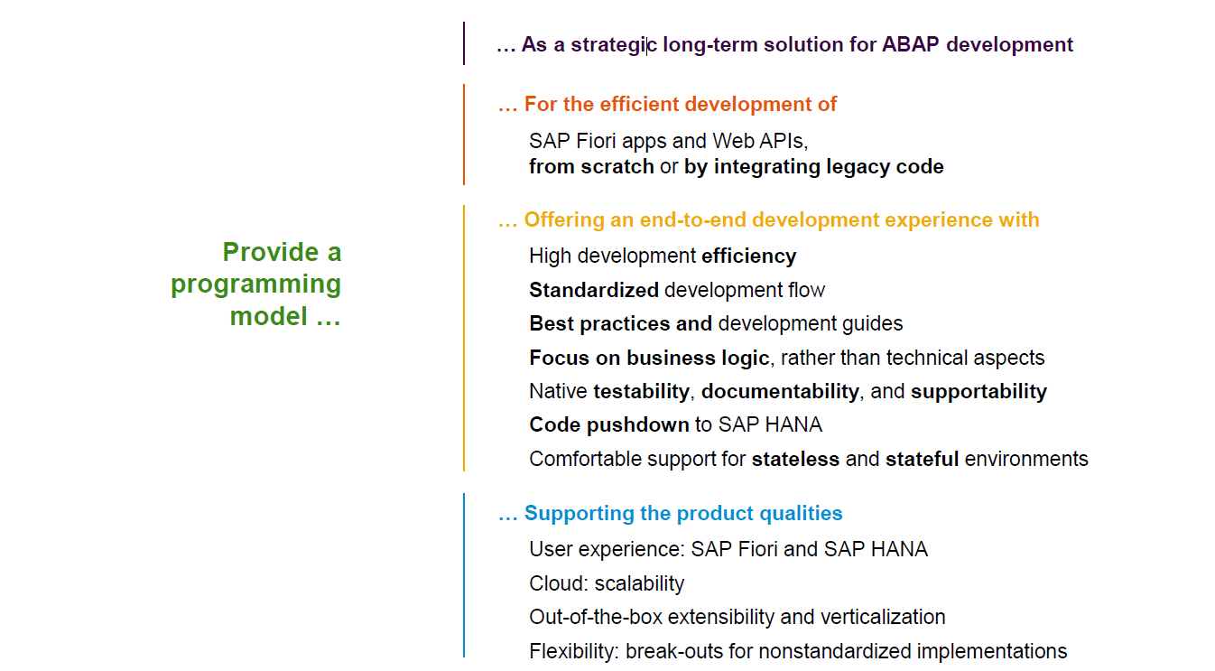
Restful ABAP Programming
www.anubhavtrainings.com

Slide 13
Restful ABAP Programming
The ABAP RAP (Restful Application Programming) Model defines the architecture for efficient application development for HANA optimized ABAP applications. It supports development of
Greenfield applications – A completely new application from scratch
Brownfield applications – A new/extension of application using OLD code
It is based on proven technologies and frameworks such as CDS entities to define semantically rich data model and service model infrastructure for creating and binding OData services for different use cases e.g. Fiori App, WebAPI, InA
www.anubhavtrainings.com

Slide 14
Components in RAP app – Technical Level
CDS entities – To develop our RAP BO (Business Object)
Business Object here is a TREE data structure which is composed of multiple nodes (parent, child), The tree starts from a root node.
Once the business object is ready, we define the behavior of the business object like can this object be created, updated, deleted. Business object is a static structure (like a class) and the records of actual data is the instance of BO (object of a class).
Finally we can create service definition and service binding
UI layer to consume the service to build application.
www.anubhavtrainings.com

Slide 15
Development Approach
Application UI (Fiori Apps)
Transactional | Analytical | Factsheet
Analytical Tools
Excel | SAC | Other..
Third Party
Your own ABAP code
Service layer (expose data over HTTP/HTTPS protocol) – OData Services (V2, V4)
SEGW, SADL, @OData, Serv. Definition and Binding
API Layer
Business logic, Data validations, Lock Unlock, Sync. Points, Branches, Manipulation logic, data flow logic, processing logic - RICEF
Customizing layer (SPRO, SM30)
Database Layer – (function modules and classes to interact with database)
LUW, Update FM, BAPIs – SELECT INSERT MODIFY UPDATE DELETE, EQ, DQ
SE11 – Data Dictionary – Tables, Views, Data Elements, Domains, LO, MC…
www.anubhavtrainings.com

Slide 16


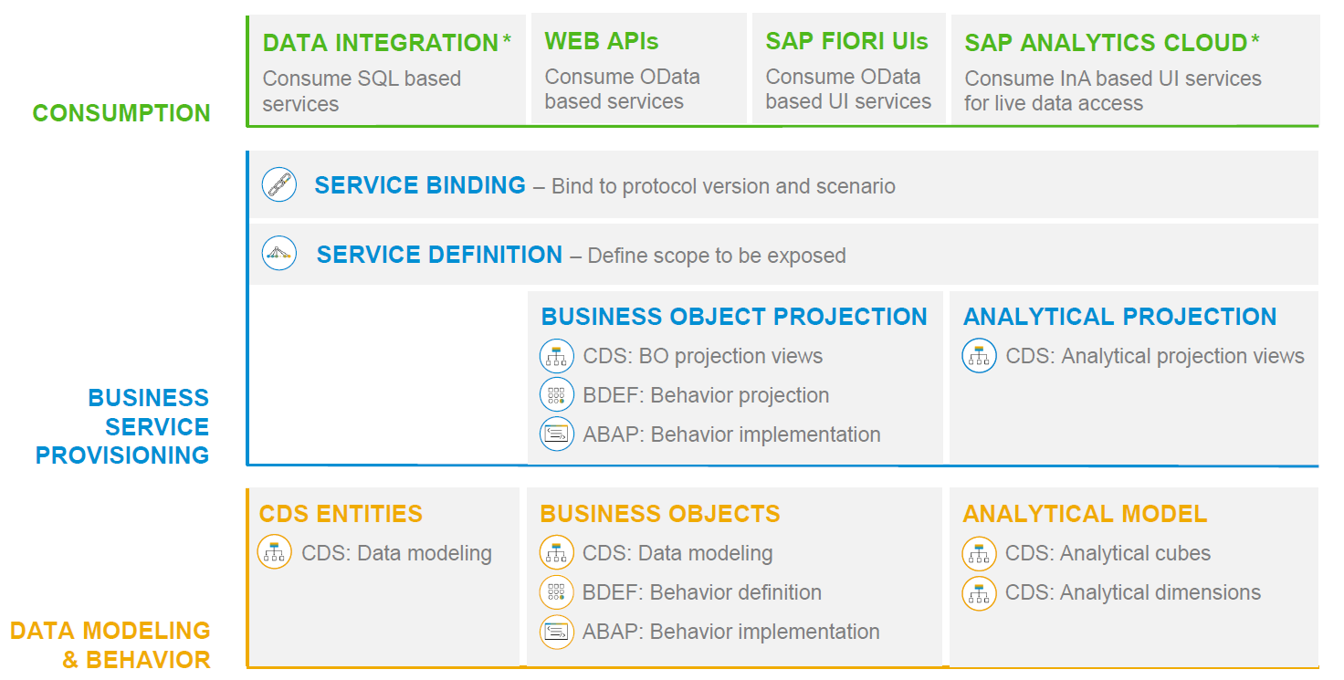
RAP – The Big picture
www.anubhavtrainings.com

Slide 17
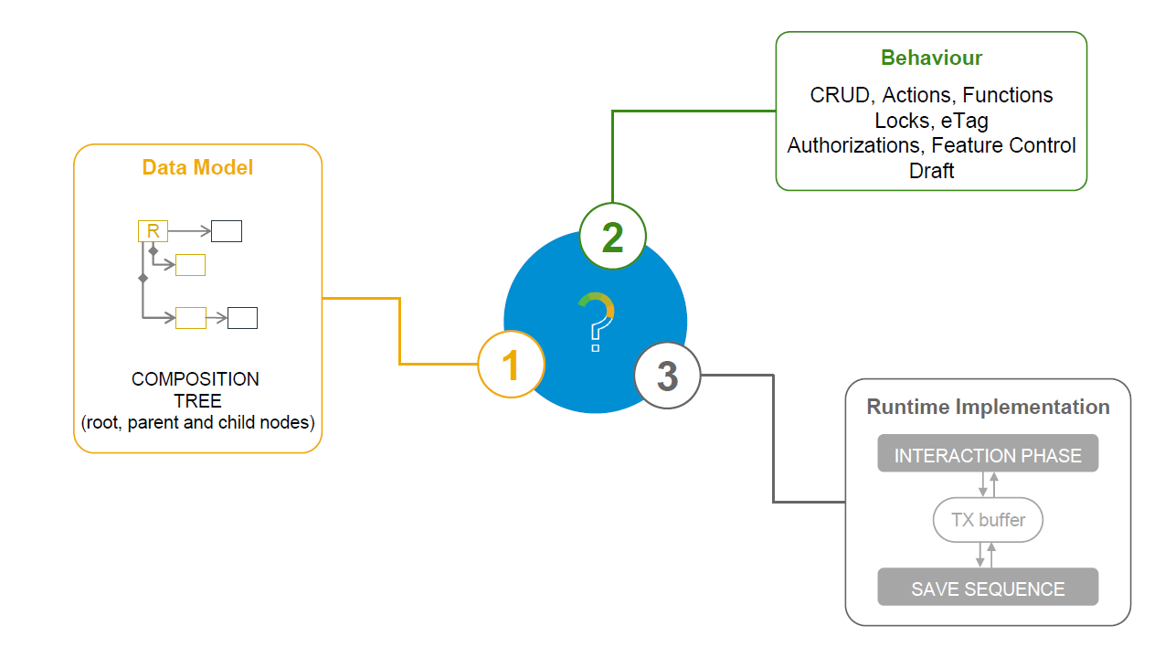
What is a Business Object
www.anubhavtrainings.com

Slide 18
Types of Implementation (Scenario)
Brownfield Implementation
Is used when we want to create a transactional application which can insert, update, delete data from the system by writing your own logic
You already have Business logic with you and you want to use that business logic to perform transactional capability
You are own your own to manage your implementation.
02. Managed Scenario
Greenfield Implementation
Is used when we want to create a transactional application which can insert, update, delete data from the system by using the framework provided implementation
You do not have Business logic with you and you want system to create business logic for you automatically.
01. Un-Managed Scenario
www.anubhavtrainings.com

Slide 19
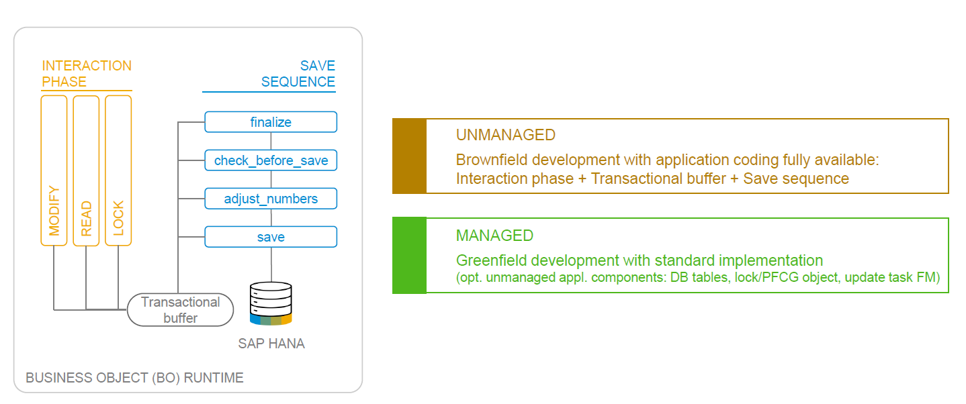
BO Runtime Implementation Types
www.anubhavtrainings.com

Slide 20

What We Did
Let’s Summarize
www.anubhavtrainings.com

Slide 21
www.anubhavtrainings.com
Thank You
End of Day 2
www.anubhavtrainings.com

Slide 22


We’re committed to empower you to be
#FutureReady
through powerful training solutions.
We build the workforce of the future.
250+
Corporate Clients
30,000+
Learners Trained
25000+
Learners Placed
FREE WEBINARS
Sign up for free webinars with industry experts every fortnight!
Enroll Now!
Contact us today!
https://anubhavtrainings.com

